Slide 1
DOCKER

Slide 2
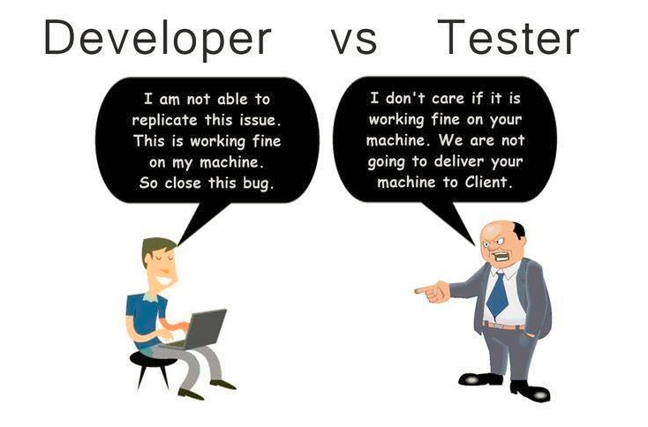
Why Docker:

Slide 3
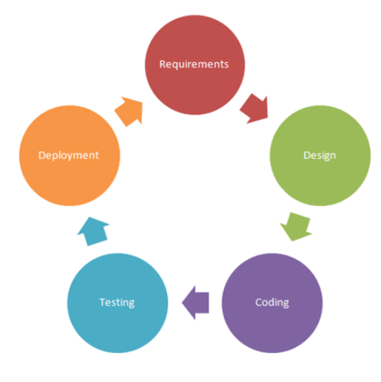
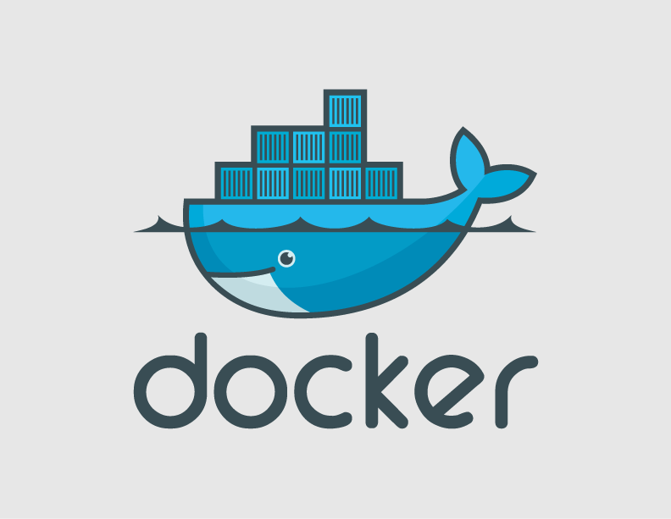
Where does Docker Operate:

Slide 4
What is Docker?
Docker is a tool designed to make it easier to create, deploy, and run applications by using containers. Containers allows to package up an application with all of the parts it needs, such as libraries and other dependencies, and ship it all out as one package. By doing so, this will resolve the issue of applications working on one environment and not on others.

Slide 5
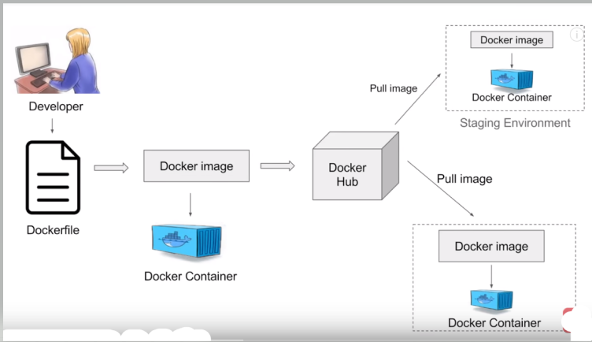
How Docker Works?

Slide 6
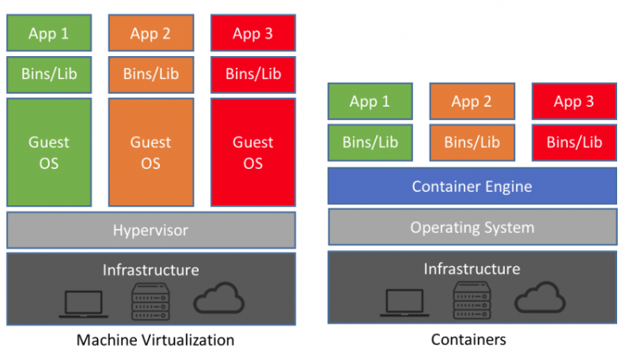
Virtualization vs Containerization:

Slide 7
Install Docker on Linux
Login to AWS console and run the below commands:
# sudo yum update –y (updates all the packages)
# sudo yum install docker –y (install docker engine)
#docker (if docker installed, it gives you all docker related commands)
#docker –version (give info about docker version)
#docker info (give information about list of docker containers, images, status, etc,.)
# sudo service docker start (starts docker service)
#docker info
#sudo usermod –aG docker ec2-user (adding user ec2-user to group docker)
#docker images (lists docker images)
#docker ps (lists docker running/active containers)
#sudo service docker stop (stops docker service)
#sudo yum remove docker (removes docker )

Slide 8
Basic Docker Commands :
#docker version (provides details about docker version)
#docker --help (lists all the docker related helpful commands)
#docker login (login to your dockerhub account www.dockerhub.com)
#docker pull <image-name> (pull docker images from docker hub)
#docker run <image name> (running docker image to create a container out of it)
# docker run –it <container name> (command to go inside a container)
#docker images –q (list the id of docker image only)
#docker image ls (list docker images present/pulled on your machine)
#docker rmi <image name/ID> (delete docker mage)
#docker ps (list active docker container)
#docker ps –a (list active as well as inactive docker containers, -a represents all)
#docker stats (give memory information, run a container and check)
#docker system df (provides details about images, containers, etc.,)
#docker system prune (this command will even delete all the dangling images, stopped containers, so we should be very careful while using prune command)

Slide 9
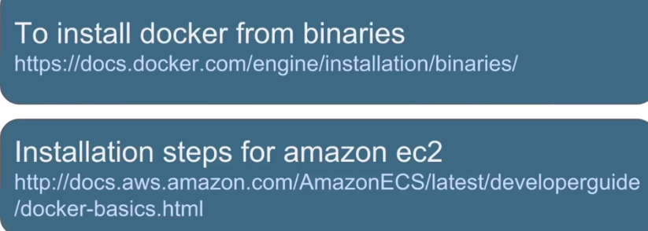
Useful links:

Slide 10
DOCKER IMAGES:
A Docker image is a file, comprised of multiple layers, used to execute code in a Docker container.
# docker run <image-name>
# docker pull <image-name>
# docker images
Dangling Images are the one associated with containers.
# docker images --help
# docker images -f dangling=true
# docker images -f dangling=false

Slide 11
DOCKER CONTAINER:
Docker Container is a run time instance of Docker Image.
# docker ps (list the active containers)
#docker run <image-name> (will create a container)
#docker start <container name/ID>
#docker stop <container name/ID>
#docker pause <container name/ID>
#docker unpause <container name/ ID>
#docker kill <container name/ID>
#docker rm <container name/ID>
#docker history <image name>

Slide 12
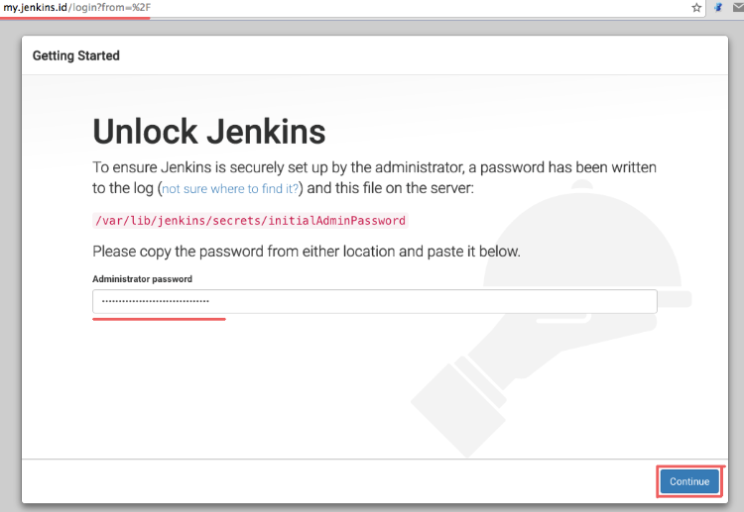
Install Jenkins on Docker Container:
Step1: Pull the Jenkins Image
Step2: Run the Jenkins Image to create a Jenkins container
Map the port number with docker port number and launch jekins dashboard by using command #docker run -p 8080:8080 -p 50000:50000 jenkins
-p stands for publish port. 50000 is the jenkins spi port number.
Go to the browser and run <public ip address of aws instance>:8080
Note: make sure that port 8080 is open, check in your security groups.
Similarly you can do this with any application, just map the port and use the port number while launching up the application.

Slide 13
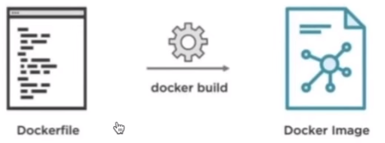
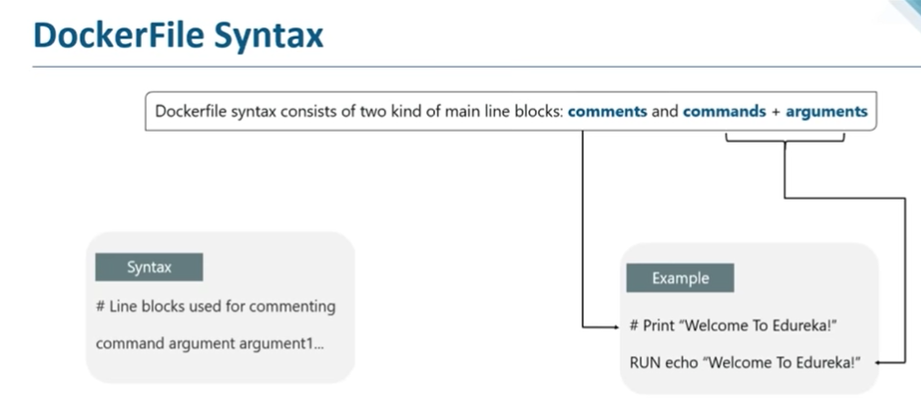
DOCKERFILE
Dockerfile is a text file with instructions to build and image.

Slide 14
Docker file Instructions:
FROM: FROM directive is probably the most crucial amongst all others for Dockerfile. It defines the base image to use to start the build process.
Eg. FROM ubuntu (here ubuntu is the base image, if we don’t want to use any image, then you can go for scratch image. (scratch is an empty image in docker hub.))
RUN: The RUN command is central executing directive for Dockerfiles. It runs at the time of image build.
Eg. RUN apt-get install apache2 –y (This will install apache2 package at th etime of image building)
CMD: It is similar to RUN, the only difference is unlike RUN, it Is not executed at the time of build. CMD runs when the container is instantiated using the image.
Eg. CMD apt-get install nginx –y
CMD echo “Hello Besant!”
ENTRYPOINT: you define your first command to be executed here.
ADD: ADD commands gets a source and a destination arguments. It copies the file from the source on the host into the container’s own filesystem at the set destination.
Eg. ADD <source path> <destination path>
WORKDIR: Its used to set where the command defined with CMD is to be executed. This command is used to change the working directory, so the CMD command will get executed in the new working directory.
EXPOSE: This command is used to expose specified port to enable networking between the running process inside the container and the outside world.
MAINTAINER: This non-executing commands declares the author. It should come after FROM.

Slide 15
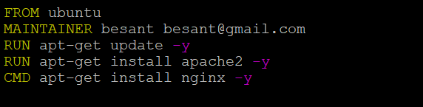
Sample Dokcerfile:
Create a folder #mkdir DockerFiles
And then # touch dockerfile
#vim dockerfile
FROM ubuntu (this give base image, if you don’t want to use base image, we have an empty image called as scratch)
MAINTAINER <your name> <your emaild id>
RUN apt-get update –y
CMD apt-get install apache2 –y
CMD [“echo”, “hello world..”] (diff b/w RUN and CMD is RUN runs gets executed during the building of image and CMD executes at the container creation)
Now build the docker file using command #docker build -t myimage .
“-t”is the name flag used to provide a name to the image “.” represents that docker file is present in the current path, you should specify your dockerfile name with –f flag only if the name of dockerfile is other than dockerfile. (by default commands take dockerfile)

Slide 16
THANK YOU

